Slide 1
REST API
BEST PRACTICES

Slide 2
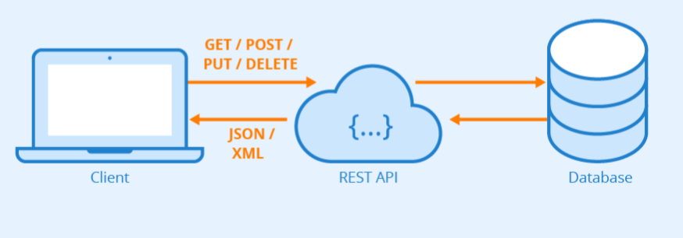
Introduction to REST API
REST = Representational State Transfer
API = Application Programming Interface

Slide 3
Best Practices for Naming REST API Endpoints
Use Nouns to Name URIs
For example, you should use https://api.example.com/users instead of https://api.example.com/getUsers
Use Clear, Unabridged Names That Are Intuitive
You should definitely avoid abbreviations and shorthand (e.g. https://api.example.com/users/123/fn instead of https://api.example.com/users/123/first-name). In some cases, the accepted or popular term for something is the abbreviation, which means you can use it. (e.g. https://api.example.com/users/ids instead of https://api.example.com/users/identification-numbers).
Use Forward Slashes to Denote URI Hierarchy
For example, you should use https://api.example.com/users instead of https://api.example.com/users/
Separate Words with Hyphens
For example, you should use https://api.example.com/123/first-name instead of https://api.example.com/123/firstName or https://api.example.com/123/first_name
Use Lowercase Letters
Avoid Special Characters
Avoid File Extensions
For example, you should use https://api.example.com/users instead of https://api.example.com/users.xml
Adjectives
For example, Instead of https://example.com/recent-posts, specify recent as the endpoint parameter.

Slide 4
Avoid using verbs in URIs
If you've understood the basics, you'll now know it is not RESTful to put verbs in the URI.
This is because HTTP verbs should be sufficient to describe the action being performed on the resource.
Let's say you want to provide an endpoint to generate and retrieve a banner image for an article. I will note :param a placeholder for an URI parameter (like an ID or a slug). You might be tempted to create this endpoint:
GET: /articles/:slug/generateBanner/
But the GET method is semantically sufficient here to say that we're retrieving ("GETting") a banner. So, let's just use:
GET: /articles/:slug/banner/
Similarly, for an endpoint that creates a new article:
# Don't
POST: /articles/createNewArticle/
# Do
POST: /articles/
HTTP verbs all the things!

Slide 5
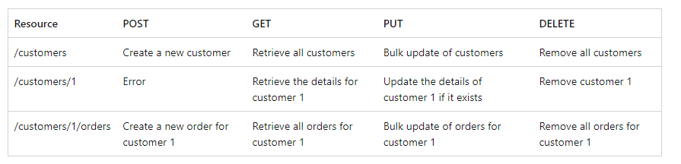
Define API operations in terms of HTTP methods
The HTTP protocol defines a number of methods that assign semantic meaning to a request. The common HTTP methods used by most RESTful web APIs are:
GET retrieves a representation of the resource at the specified URI. The body of the response message contains the details of the requested resource.
POST creates a new resource at the specified URI. The body of the request message provides the details of the new resource. Note that POST can also be used to trigger operations that don't actually create resources.
PUT either creates or replaces the resource at the specified URI. The body of the request message specifies the resource to be created or updated.
PATCH performs a partial update of a resource. The request body specifies the set of changes to apply to the resource.
DELETE removes the resource at the specified URI.

Slide 6
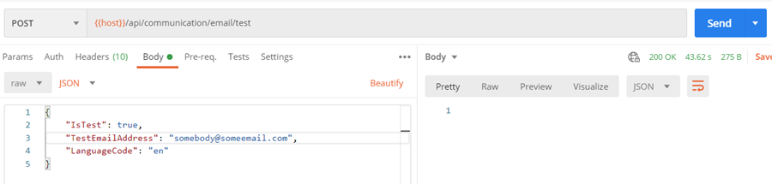
REST API Must Accept and Respond With JSON
It is a common practice that APIs should accept JSON requests as the payload and also send responses back. JSON is a open and standardized format for data transfer. It is derived from JavaScript in a way to encode and decode JSON via the Fetch API or another HTTP client. Moreover, server-side technologies have libraries that can decode JSON without any hassle.
Let’s have a look at an example of API where JSON accepts payloads. A screenshot from Postman to send JSON to our API.

Slide 7
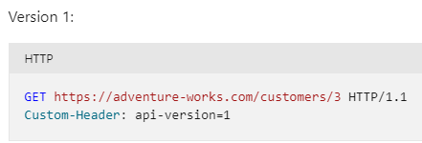
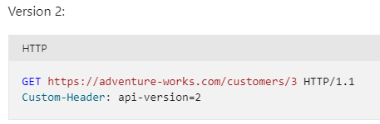
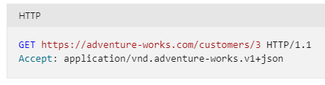
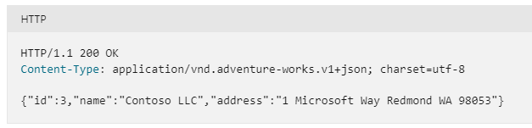
URI Versioning
Query string versioning
For example, https://example.com/customers/3?version=2
Header versioning
Media type versioning

Slide 8
API Response Best Practices
Response Header:
Provide proper http response status code.
Return Error Details in the Response Body
Provide proper content type, file type if any.
Provide cache status if any.
Authentication token should provide via response header.
Only string data is allowed for response header.
Provide content length if any.
Provide response date and time.
Follow request-response model described before.

Slide 9
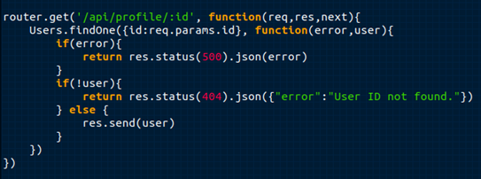
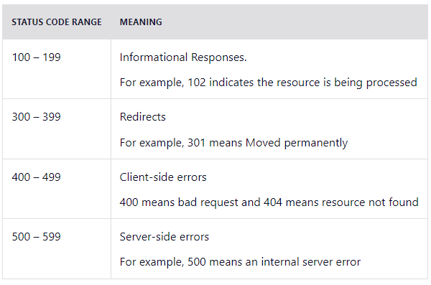
Go With Error Status Codes
Over 100 status codes have already been built by HTTP. It is a boon for developers to use status codes in their REST API design. With the status codes, developers can instantly identify the issue, which reduces the time of writing parsers to address all the different types of errors. There’s a status code for everything – from finding out the cause of a denied session to locating the missing resource. Developers can quickly implement routines for managing numerous errors based on status codes.

Slide 10
Use Filtering, Sorting, and Pagination to Retrieve the Data Requested
Sometimes, an API's database can get incredibly large. If this happens, retrieving data from such a database could be very slow.
Filtering, sorting, and pagination are all actions that can be performed on the collection of a REST API. This lets it only retrieve, sort, and arrange the necessary data into pages so the server doesn’t get too occupied with requests.
An example of a filtered endpoint is the one below:
https://mysite.com/posts?tags=javascript&limit=25
This endpoint will fetch any post that has a tag of JavaScript.

Slide 11
Use SSL for Security
When you have to encrypt the communication with your API, always use SSL/TLS. Use this feature without asking any questions. SSL stands for secure socket layer. It is crucial for security in REST API design. This will secure your API and make it less vulnerable to malicious attacks. SSL certificates are not hard to load to a server and are available for free mostly during the first year. They are not expensive to buy in cases where they are not available for free.
The clear difference between the URL of a REST API that runs over SSL and the one which does not is the “s” in HTTP:
https://mysite.com/posts runs on SSL.
http://mysite.com/posts does not run on SSL.

Slide 12
Use Resource Nesting
Resource objectives always contain some sort of functional hierarchy or are interlinked to one another. However, it is still ideal to limit the nesting to one level in the REST API. Too many nested levels can lose their elegant appeal. If you take a case of the online store into consideration, we can see “users” and “orders” are part of stores. Orders belong to some user; therefore the endpoint structure looks like:
/users // list all users
/users/123 // specific user
/users/123/orders // list of orders that belong to a specific user
/users/123/orders/0001 // specific order of a specific users order list

Slide 13
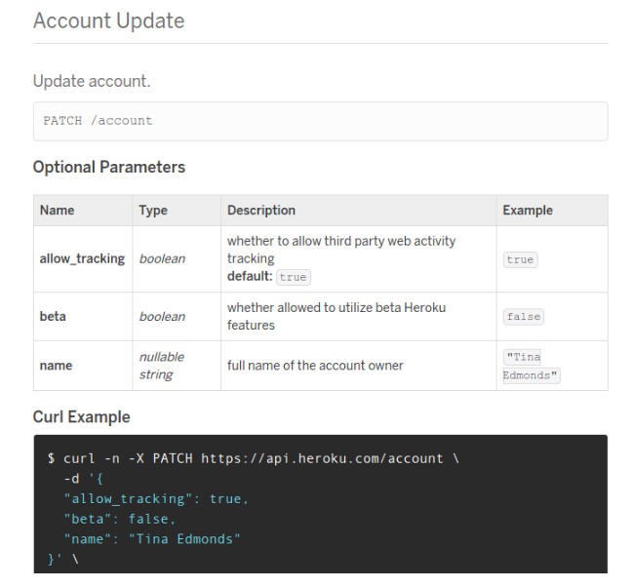
Well Compiled Documentation
Documentation is one of the important but highly ignored aspects of a REST API structure. The documentation is the first point in the hands of customers to understand the product and critical deciding factor whether to use it or not. One good documentation is neatly presented in a proper flow to make an API development process quicker.
It is a simple principle – the faster developers understand your API, the faster they start using it. Your API documentation must be compiled with precision. It must include all the relevant information such as the endpoint and compatible methods, different parameter options, numerous types of data, and so on. The documentation should be so robust that it can easily walk a new user through your API design.

Slide 14
REST API SECURITY
BEST PRACTICES

Slide 15
REST API Security Best Practices
Security Practices May Varies
May varies from application to application
May varies from developer to developer
May varies from environment to environment
May varies from use case to use case
But we have to know
The best practices
Know about the security layers
Security placement

Slide 16
REST API Security
Client Application
API END POINT
Request
API Key Verification
User Agent Verification
CSRF Protection
Response
Rate Limiting
Security Layer
HTTP Secure Headers
Parameter Pollution
Payload Validation
Controller
Data Sanitization
Response Validation
Authentication/Authorization

Slide 17
Output Validation
Output Header:
Provide proper http response status code.
Provide proper content type, file type if any.
Provide cache status if any.
Authentication token should provide via response header.
Only string data is allowed for response header.
Provide content length if any.
Provide response date and time.
Follow request-response model described before.
Output Body:
Avoid providing response status, code, message via response body
Use JSON best practices for JSON response body.
For single result, can use String, Boolean directly.
Provide proper JSON encode-decode before writing JSON Body.
Follow discussion on JSON described before.

Slide 18
Request Rate limit- Throttling
We need to make sure our APIs are running as efficiently as possible. Otherwise, everyone using your database will suffer from slow performance. Performance isn’t the only reason to limit API requests, either. API limiting, which also known as rate is limiting, is an essential component of Internet security, as DoS attacks can tank a server with unlimited API requests.
Rate limiting also helps make your API scalable. If your API blows up in popularity, there can be unexpected spikes in traffic, causing severe lag time.
Language | Platform | Library name | Library Sources
C# | ASP.NET | WebApiThrottle, MvcThrottle | Nuget package manager
PHP | Laravel | Laravel Karnel Default | Packagist
JS | Node/Express JS | express-rate-limit | NPM

Slide 19
CSRF/XSRF Protection
Cross-site request forgery attacks (CSRF or XSRF for short) are used to send malicious requests from an authenticated user to a web application.
Use request-response header to pass CSRF token
CSRF token should be unique for every session
For self API CSRF token works well.
Language | Platform | Library name | Library Sources
C# | ASP.NET | AntiCSRF | Nuget package manager
PHP | Laravel | Laravel Default | Packagist
JS | Node/Express JS | npm i csrf | NPM

Slide 20
User Agent Protection
User agent is a request header property, describe client identity like operating system, browser details, device details etc. Moreover every web crawler like Google crawler, Facebook crawler has specific user-agent name.
Using user agent we can prevent REST API from search engine indexing, social media sharing.
Can stop subspecies request from who is hiding his identity.
We can add user agent along with REST API usage history.
We can add device/OS usage restriction.

Slide 21
REST API Security Best Practices
Platform | Example User Agent Like
Android web browser | Mozilla/5.0 (Linux; Android 6.0.1; RedMi Note 5 Build/RB3N5C; wv) AppleWebKit/537.36 (KHTML, like Gecko) Version/4.0 Chrome/68.0.3440.91 Mobile Safari/537.36
IOS web browser | Mozilla/5.0 (iPhone; CPU iPhone OS 12_3_1 like Mac OS X) AppleWebKit/605.1.15 (KHTML, like Gecko) Version/12.1.1 Mobile/15E148 Safari/604.1
Windows | Mozilla/5.0 (Windows NT 10.0; Win64; x64) AppleWebKit/537.36 (KHTML, like Gecko) Chrome/74.0.3729.169 Safari/537.36
Mac | Mozilla/5.0 (Macintosh; Intel Mac OS X 10_11_6) AppleWebKit/605.1.15 (KHTML, like Gecko) Version/11.1.2 Safari/605.1.15
Google BOT | Mozilla/5.0 (compatible; Googlebot/2.1; +http://www.google.com/bot.html)
Facebook BOT | facebookexternalhit/1.0 (+http://www.facebook.com/externalhit_uatext.php)

Slide 22
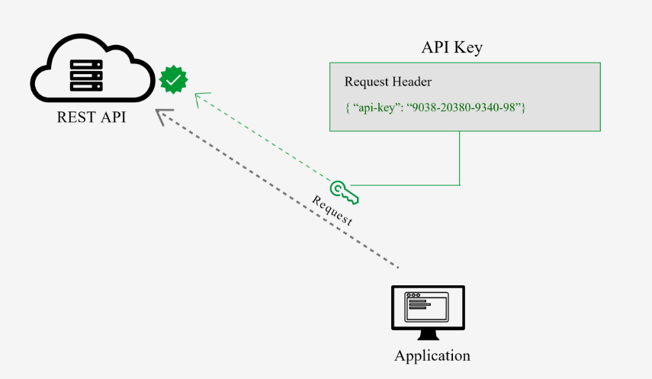
API Key
This is the most straightforward method and the easiest way for auth
With this method, the sender places a username:password/ ID / Keys into the request header.
The credentials are encoded and decode to ensure safe transmission.
This method does not require cookies, session IDs, login pages, and other such specialty solutions

Slide 23
Bearer Authentication/ Auth 2.0
Bearer authentication (also called token authentication) is an HTTP authentication scheme that involves security tokens called bearer tokens, passes through request-response header. In General JSON Web Tokens JWT used for this purposes.
Language | Platform | Library name | Library Sources
C# | ASP.NET | JwtBearer, jose-jwt | Nuget package manager
PHP | Laravel | firebase / php-jwt | GitHub
JS | Node/Express JS | npm i jsonwebtoken | NPM

Slide 24
JWT (JSON WEB TOKEN)
Compact and self-contained way for securely transmitting information between parties as a JSON object.
Information can be verified and trusted because it is digitally signed.
USES:
Authorization: Allowing the user to access routes, services, and resources
Information Exchange: Way of securely transmitting information between parties.

Slide 25
JSON WEB TOKEN STRUCTURE
Header
Payload
Signature

Slide 26
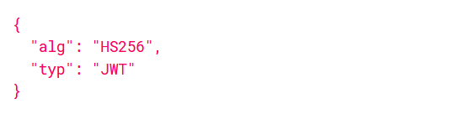
JSON WEB TOKEN HEADER
Type of the token
Signing algorithm

Slide 27
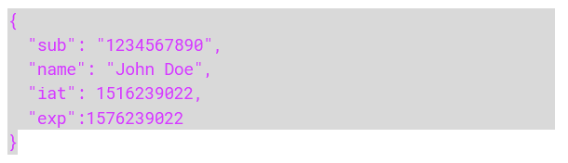
JSON WEB TOKEN PAYLOAD
Registered claims: iss (issuer), exp (expiration time), sub (subject), aud (audience)
Public claims: These can be defined at will by those using JWTs.
Private claims: These are the custom claims created to share information between parties.

Slide 28
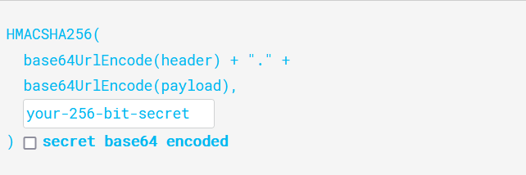
JSON WEB TOKEN SIGNATURE
To create the signature part -
Take the encoded header
Take the encoded payload, a secret
The algorithm specified in the header

Slide 29
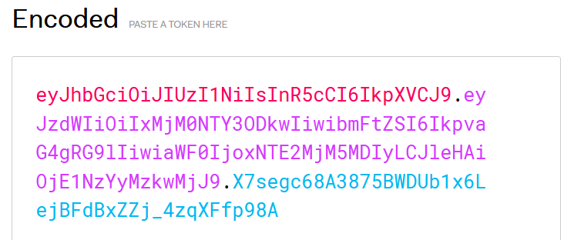
JSON WEB TOKEN
Putting all together

